Slide 1


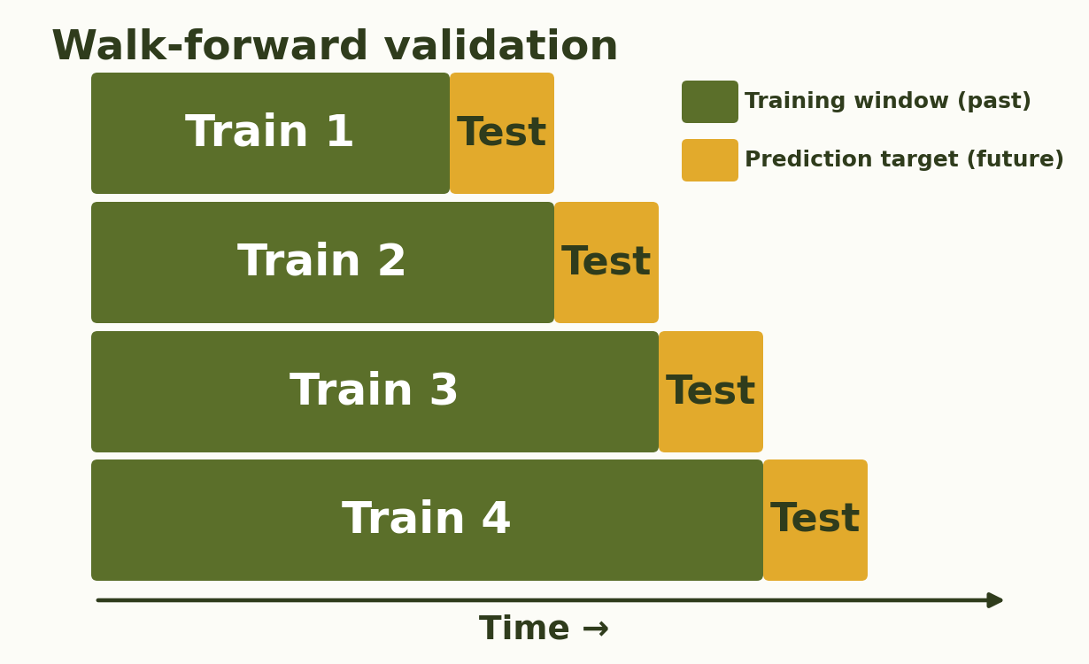
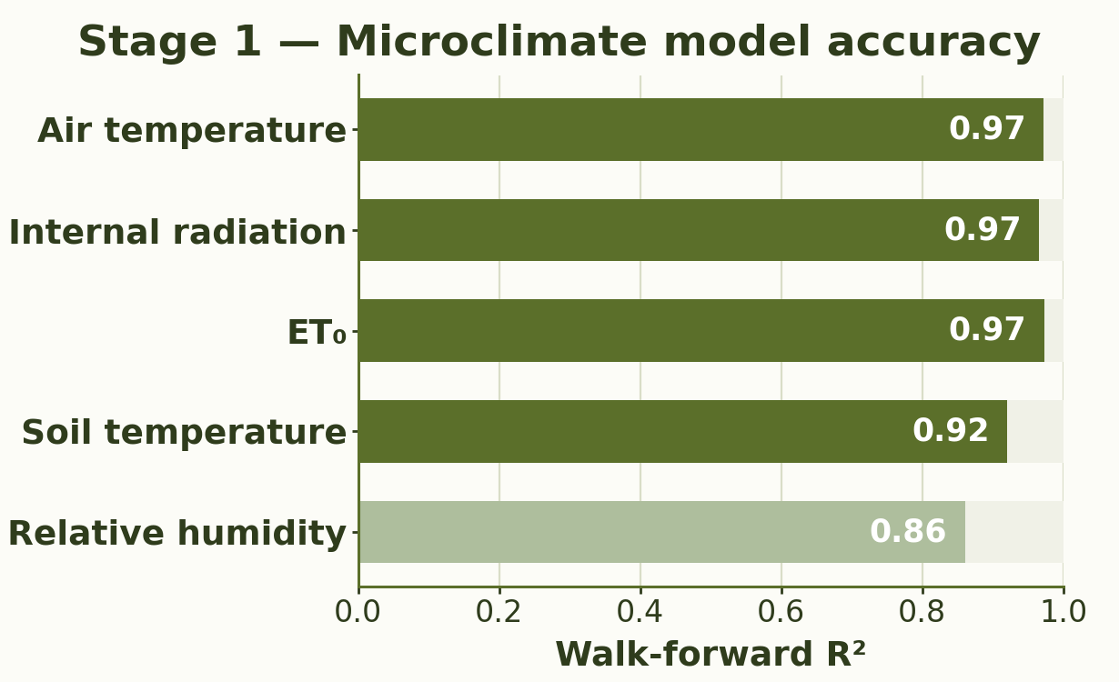
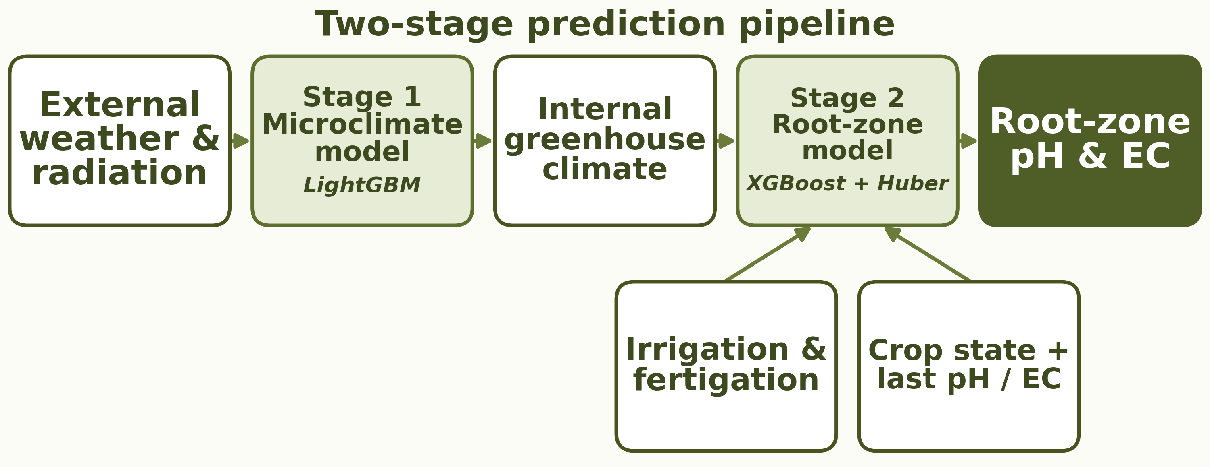
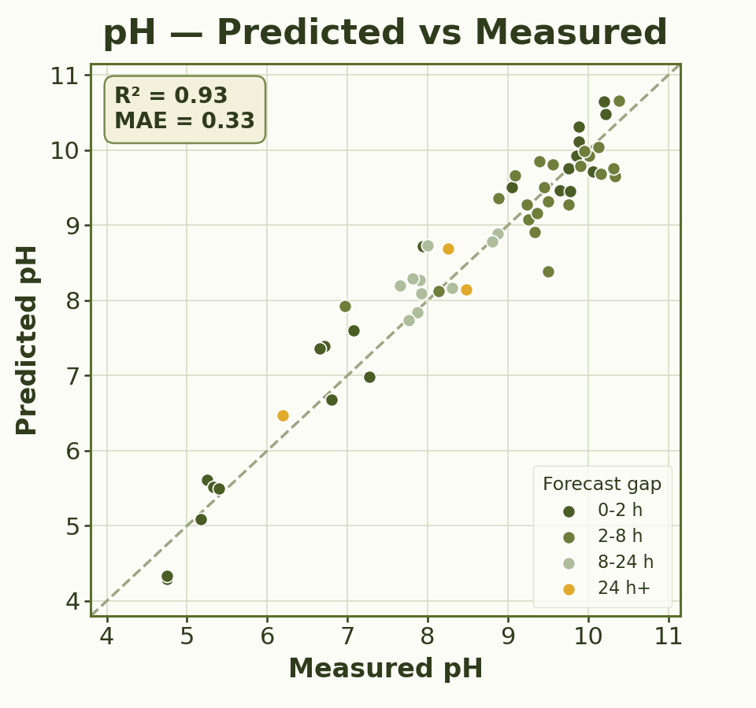
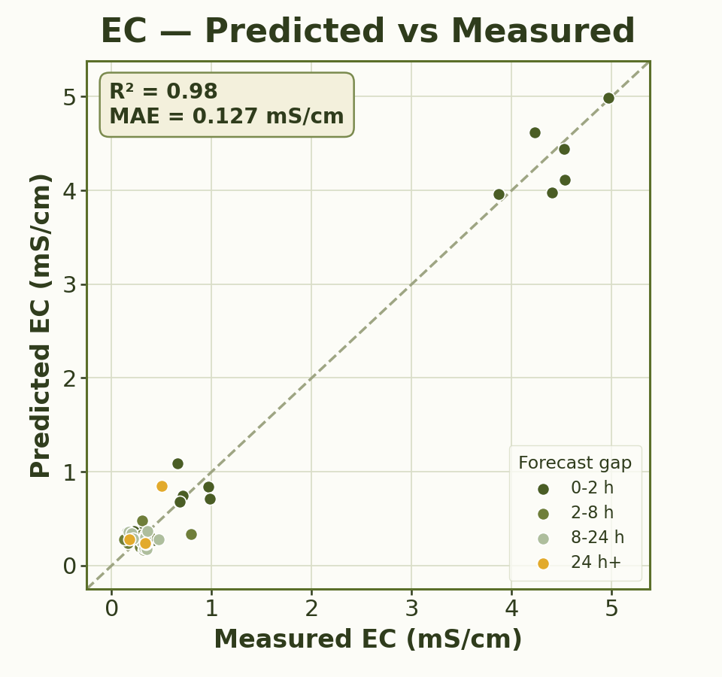
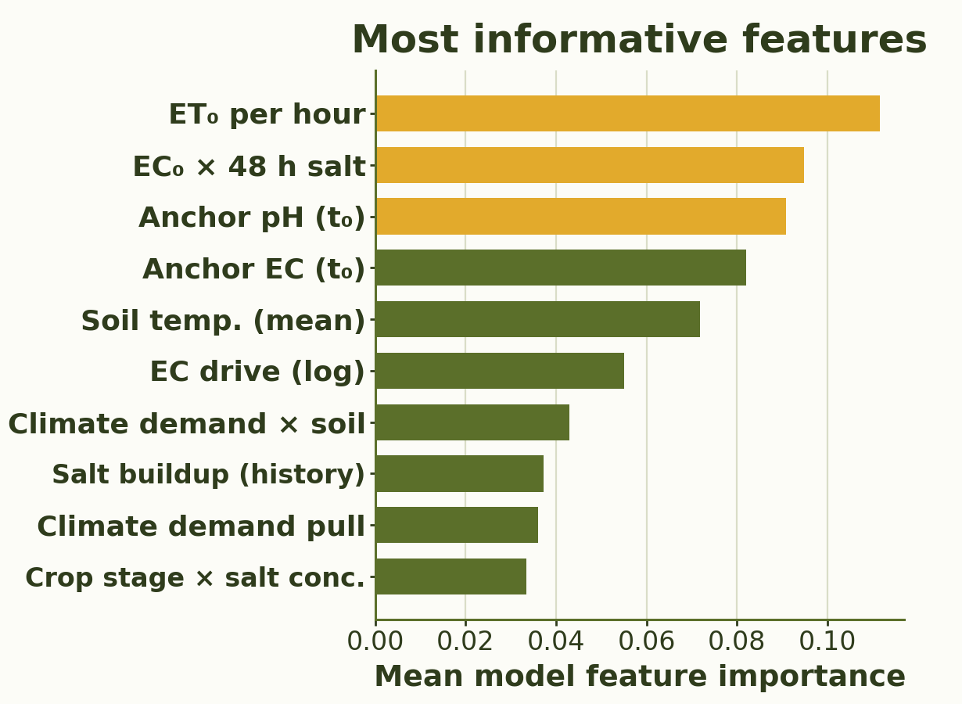
RUPPIN ACADEMIC CENTER · DEPARTMENT OF COMPUTER SCIENCE · AI & DATA SCIENCE SPECIALIZATION
Predictive Modeling of Root-Zone Variables Using Greenhouse Data
Students: Eden Eliyahu, Oren Chaushu
Supervisors: Dr. Avner Priel, Dr. Alaa Jamal
01
Motivation
06
Validation Strategy
Root-zone pH and electrical conductivity (EC) indicate nutrient status, salinity, and fertilizer effects. In greenhouses, they are often measured manually and infrequently, leaving gaps where irrigation, fertigation, climate, and plant uptake changes may be missed. Predictive modeling can estimate pH and EC under planned irrigation/fertigation actions, helping growers adjust management before conditions drift.
▪ Walk-forward validation matches deployment: future pH/EC is predicted using only past pH/EC measurements, forecast climate, and planned irrigation/fertigation.
▪ Future pH/EC samples are withheld from training until they become available, preventing data leakage.
02
Project Goal
▪ Develop a soft sensor that predicts future root-zone pH and EC using the latest pH/EC measurement, forecast climate, planned irrigation/fertigation, and crop-state data.
▪ Estimate t₀ → t₁ changes in pH and EC, allowing growers to evaluate planned irrigation/fertigation strategies and adjust management before conditions drift.
07
Microclimate Model
03
Data
▪ Predicts internal greenhouse microclimate from external weather and radiation.
▪ Generates continuous inputs for the root-zone model: temperature, RH, radiation, ET₀, and soil temperature.
16,682
10-min records
109
pH/EC samples
+20
input features
Unified 10-minute master dataset, May 29 – Sep 21, 2025: ▪ External weather & solar radiation — weather station and solar sensor
▪ Greenhouse microclimate — internal sensor data ▪ Irrigation & fertigation — scheduled management inputs ▪ Crop-state features — canopy-cover observations ▪ Manual pH & EC measurements — lab-measured model labels
04
Method
Two-stage prediction pipeline:
1. Forecast internal greenhouse microclimate from external weather and radiation.
2. Predict t₀ → t₁ ΔpH/ΔEC from forecast climate, crop state, and planned events.
08
Root-zone Model Results — Walk-forward Test
0.33 pH MAE
0.93 pH R²
+62% pH MAE reduction
0.13 EC MAE
0.98 EC R²
+35% EC MAE reduction
n = 57 prediction intervals · MAE reduction vs. persistence baseline
05
Algorithms & Model Choice
Hybrid model choice: nonlinear prediction + robustness to sharp-change intervals.
Gradient Boosting
Main nonlinear model for tabular greenhouse data. Captures interactions between climate, irrigation, fertigation, crop state, and baseline pH/EC.
Huber Regressor
Robust companion model for sharp pH/EC shifts. Reduces sensitivity to extreme intervals linked to acid, fertigation, or salinity changes.
09
Conclusions
▪ Prediction value → Reduced MAE vs. baseline (+62% pH, +35% EC), supporting earlier pH/EC drift detection.
▪ Decision-support prototype → Allows growers to test planned irrigation/fertigation actions before applying them.
▪ Soft-sensor feasibility → Sparse samples can produce useful forecasts when combined with dense greenhouse data.
10
Challenges & Limitations
▪ Sparse pH/EC labels → modeled ΔpH/ΔEC between measured samples
▪ Missing climate inputs → filled greenhouse gaps with microclimate predictions
▪ Irregular sampling → used time-gap and window aggregation features
▪ Small EC changes → modeled relative EC change and evaluated with MAE
▪ Limited generalization → requires testing across more seasons, crops, and greenhouses

